Slide 1

Info8105
System Development Project​​
Pitch

Slide 2

Project Name
SMALL BUSINESS APPL(All Purpose App)
About

Slide 3


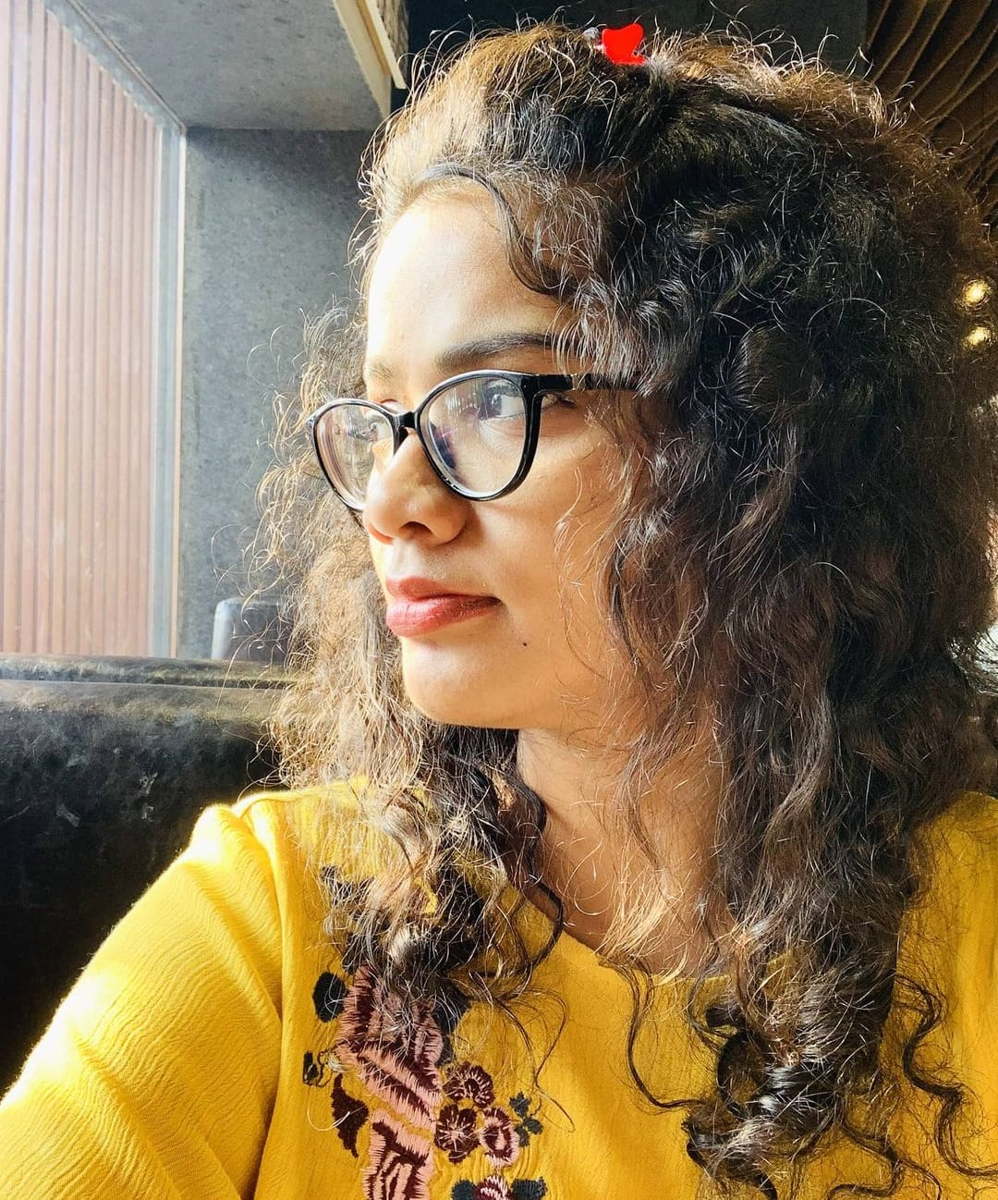
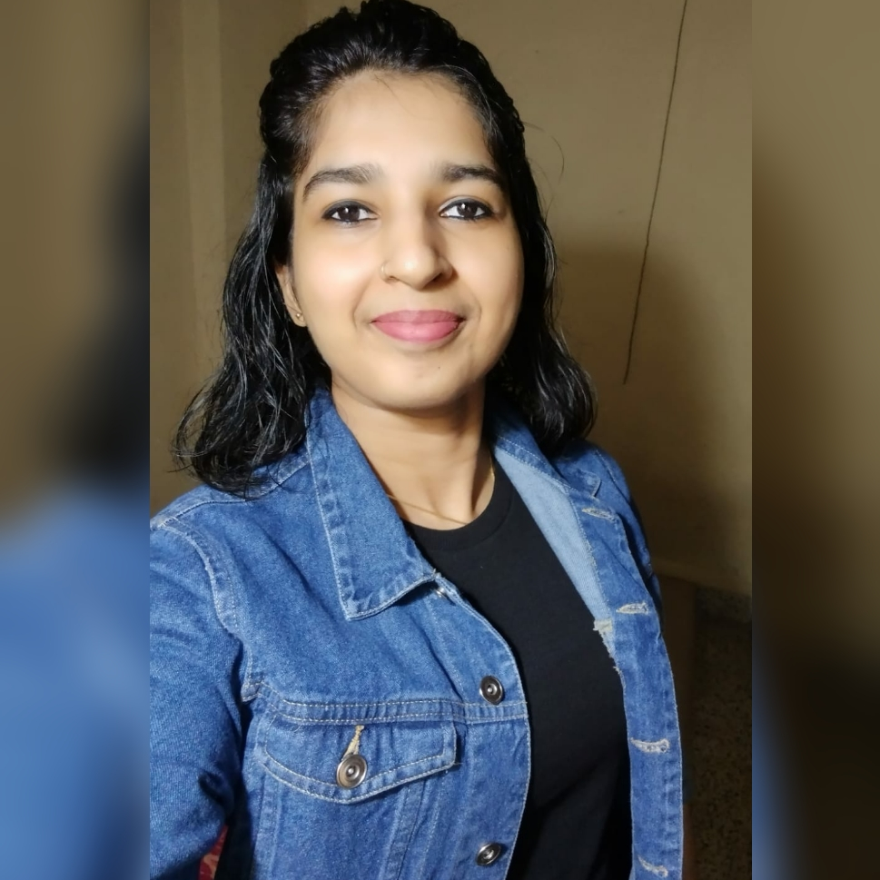
MEET THE TEAM
​
PRANAV KHAVARE
PRIYANKA SHARMA
RASHMI ANCHAN

Slide 4
Our Mentor
RICK GUZIK
Pitch

Slide 5

Our Project Aim
III
Our project aim is basically focused for the entrepreneurs who wants to start their business online to ensure 100% accuracy.

Slide 6

Project Description
This project is to help local small business owners to have an online store that will help them to conduct their business online, be in control of their online store while being cost effective.
Our proposed system would be a desktop web application which will be committed to a single company and can be used by multiple small business owners as per their requirements with flexibility to customize the platform as required.
Business
Technologies Used
Frontend: ReactJS
Backend: Java & Spring Boot
Database: MS SQLServer ​

Slide 7

Problem
Market gap
Customers
Events
Forced to use app specific loyalty programs
Available choices: UberEats, DoorDash, SkipTheDishes
No option for bulk orders and special events
Costs
Usability
Premium charges for the application ​are applied
Troublesome to update Menus/Items.

Slide 8
SOLUTION
Orders
Delivery
Market Prospects
Cost
Order Management
Store front, allows customers to place orders
Scheduled Delivery
Smart Curation
Marketing and Advertisement Management
Cost effective solution

Slide 9

Thank You
CAD – TEAM 7​​
Pranav Khavare
Priyanka Sharma
Rashmi Anchan​
Than

